Slide 1

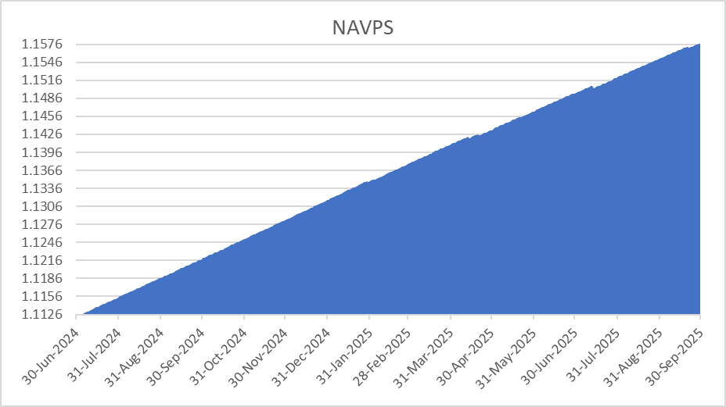
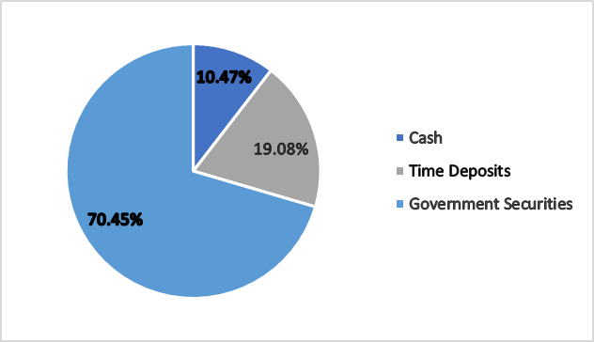
AIB MONEY MARKET MUTUAL FUND, INC.
FUND FACT SHEET AS OF SEPTEMBER 30, 2025
FUND OVERVIEW
The primary objective in this investment is safeguarding capital while also generating returns. To achieve this, funds are allocated to a mix of short-term fixed income investments, in both Philippine Peso and Foreign currency. These investments are sourced from the Philippine government and Filipino corporations, ensuring a balance of security and potential growth for your invested capital.
PRODUCT SUITABILITY
This investment opportunity is suitable for individuals seeking a conservative approach with their finances and aiming for a short-term commitment, ideally ranging from six (6) months to one (1) year.
FUND DETAILS |  | TOP FIXED-INCOME SECURITIES
Fund Classification | Money Market Fund | NAME |  | MATURITY |  | %
Risk Profile | Conservative | RPTB 0 11/26/25 |  | 2025 |  | 18.56%
Fund Currency | Philippine Peso | RPTB 0 01/28/26 |  | 2026 |  | 12.17%
Fund Size | Php 173.90 M | RPTB 0 11/05/25 |  | 2025 |  | 11.66%
Net Asset Value Per Share (NAVPS) | 1.1578 | BSP BILLS 11/11/25 |  | 2025 |  | 9.71%
Management Fee | up to 0.50% p.a. | BSP BILLS 10/07/25 |  | 2025 |  | 8.72%
Minimum Initial Investment | Php 1,000 | CUMULATIVE RETURNS
Minimum Additional Investment | Php 1,000 | 1 mo | 6 mos | 1 YR | YTD*
Minimum Holding Period | 7 Calendar Days | 0.23% | 1.45% | 3.21% | 2.32%
Sales Load | None | * Year-to-date return is calculated as the return from the beginning of the year until the reporting day.
Early Redemption Fee | 1%
NAVPS GRAPH
INVESTMENT MIX
Investment in the Fund is not insured or guaranteed by the Philippine Deposit and Insurance Corporation (“PDIC”).
Returns are not guaranteed, and historical prices are provided for illustration purposes only.
The price at the time of subscription may differ from the price at redemption and any losses will be solely for the account of the client.
AIBAAMI is not liable for any losses unless upon willful default, bad faith or gross negligence.
AIBAAMI is regulated by the Securities and Exchange Commission. For consumer assistance and financial consumer complaints, you may contact the Markets and Securities Regulation Department through msrd_covid19@sec.gov.ph or (02) 8818-7164 and/or (02) 8818-8178.
For inquiries, feedback and/or complaints, you can call us at (02) 8588-4242, and/or email us at information@aibaami.com

